Slide 1

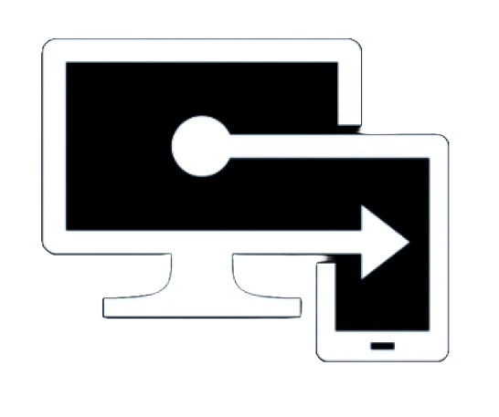


Tools and Features
By:- Team

Slide 2

















Overview of Configuration Manager(SCCM) Features
Asset Management
Deployment
Compliance Management
Security
Hardware and Software Inventory
Application Management
Compliance Settings
Role based administration
Software Update/O365 Management
Power Management
Endpoint Protection
Software Metering
Scripts
Operating System Deployment
Client Health
Reporting
Remote Management
Third party driver and application Management
Bulk operations
Feature Present
Monitoring
Feature Not Present
Co management
Feature Using
Microsoft Store for business apps
Feature Not Using
ADR

Slide 3

Overview of Microsoft Intune Features
Asset Management
Deployment(Co management)
Compliance and Configuration Policies
Security
Hardware and Software Inventory
Application Management
Compliance Settings
Role based administration
Configuration Profiles
Endpoint Protection
Software Update/O365 Management
Remote help tool
Scripts / Proactive Remediation
Autopilot
Reporting
Endpoint Analytics
Feature Update
Monitoring
Feature Present
Monitoring
Feature Not Present
Microsoft Store apps
Feature Using
Autopatch
Feature Not Using
Note:- We are utilizing some features partially due to (BAU) scope…

Slide 4
SCCM and Intune Features
Feature | SCCM | Intune | Recommendation | Challenges In Intune/SCCM
Windows Patching/ OOB updates | Yes Using | Not Using | Move WorkLoad to use Intune feature | Cannot deploy selective updates in Intune (WUFB tool Limitation)
OS Servicing /Feature Upgrade | Yes Using | Not Using | Move WorkLoad to use Intune feature
Apps Management / Win32 Apps | Yes Using | Yes Using | Workload already on Inutne
O365 Patching | Yes Using | Possible using Autopatch / setting catalogs/admx templets | Move WorkLoad to Use Autopatch Intune feature
Hardware Inventory | Detailed Reporting | Limited Inventory | User PowerShell / Graph API to create Reports | Very Basic Inventory information in Intune
Software Inventory | Detailed Reporting | Limited Inventory | User PowerShell / Graph API to create Reports (Limited options) | Very Basic Inventory information in Intune
Software Metering | Yes Using | Feature is not available | Explore Alternative
OS deployment PXE Boot | Yes Using | Feature is not available | User 100% Autopilot deployment
Windows Autopilot | Feature not available | Yes Using | Already Using in Production
Configuration Baseline | Yes(Configuration Baseline) | Not Using
Endpoint Analytics | Feature available | Feature available
Proactive remediation | Feature available and Using. | Feature available
ADR (SCCM) /Autopatch(Intune) | Yes Using | Feature available (Update ring /Autopatch) | Use Windows Autopatch

Slide 5
SCCM and Intune Features
Feature | SCCM | Intune | Recommendation | Limitations In Intune/SCCM
Reports | Yes Using | Feature is available |  | In Intune limited reports are available compared to SCCM
Client Management /Enrollment | Yes Using | Feature is available
CMG | Yes Using | Feature is not available / Required |  | Intune is itself a cloud based service to manage Endpoints.
Compliance Policies | Yes Using (Limited) | Feature is available | Move WorkLoad to use Intune feature
Device Configuration | Yes Using (Limited) | Feature is available | Move WorkLoad to use Intune feature
3rd Party Apps Patching | Feature is available | Feature is not available | MS Soon Release this in Feb 2024 | Working on PMPC POC
Driver update | Feature is available | Feature is available | Move WorkLoad to use Intune feature
Co-management (Workload is shifted only for Endpoint Security and Application Management) | Enabled for all devices | Enabled for all devices
GPO | Using AD to deploy GPO | Use Configuration Profile to deploy setting | Feature is not available

Slide 6
Major features we miss if we use stand alone Intune
Co management / Tenant attach / CMG / Workload functionality will be removed (No Major Impact)
Selective windows update/O365 deployment is not possible ( by design).
Very basic hardware / software inventory via PowerShell / Graph API / Graph explorer (Custom PS Scripts Needed)
Limited functions on Remote help tool ( No Impact as we are using Log me In ).
Software metering is not available in Intune. (We have to explore alternative id this is critical requirement)
Limited reports available( default reports). ( Custom PS Scripts Needed )
Limited logs for troubleshooting compared to SCCM. (This is tool Limitation Specific to patching troubleshooting)
Limited conditions / rules to create dynamic user/device groups. (Tool Limitation but alternative are available like exclude / include filters )
OS deployment on BareMetal is not possible ( by design).
C$ of devices cannot be accessible for troubleshooting. ( Need Remote session to troubleshoot specific device issues )

Slide 7
Current Workload Management Status
Workload | SCCM | Pilot Intune | Intune
Compliance Policies |  | Yes ( 3 devices)
Device Configuration |  | Yes ( 4 devices)
Endpoint Protection |  |  | Yes
Resource Access Policies |  | Yes ( 4 Devices)
Client Apps |  |  | Yes
Office Click to run Apps | Yes

